Slide 1
Intro to oneAPI, the Intel AI Analytics Toolkit, and OpenVINO

Slide 2
Content
oneAPI
Intel AI Analytics Toolkit
OpenVINO
Kahoot Activity
OpenVINO Activity

Slide 3
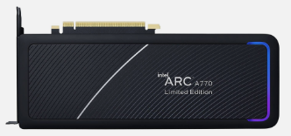
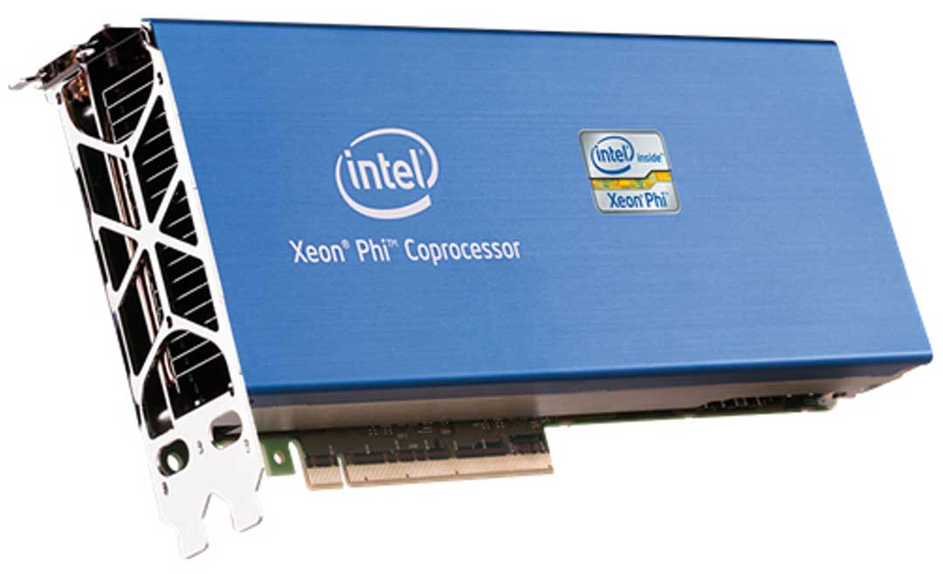
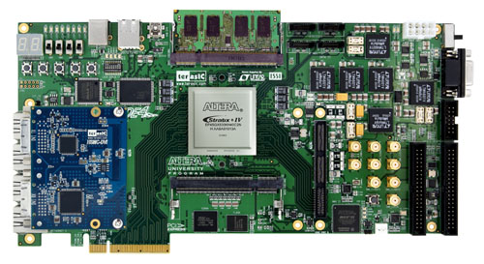
Modern AI Problems
AI can be found in all modern applications like:
Robots
Websites
Cellphone cameras
Etc.
AI, however, needs a lot of computing power to process all the information is given.
Because of that, scientist use special equipment to accelerate this process
This equipment falls into the category of Hardware accelerators. Ex:
GPUs
Coprocessors
FPGAs
others

Slide 4
What is oneAPI?
oneAPI is an open standard for a unified application programming interface for communication across multiple hardware
In simple words, oneAPI is:
The initiative of creating a programming language and libraries that can be used across multiple architectures
By doing the previous:
We can re-use code we wrote for specific devices
We won’t need to update most of the code when newer technologies come
We can make communication between devices relatively easy

Slide 5
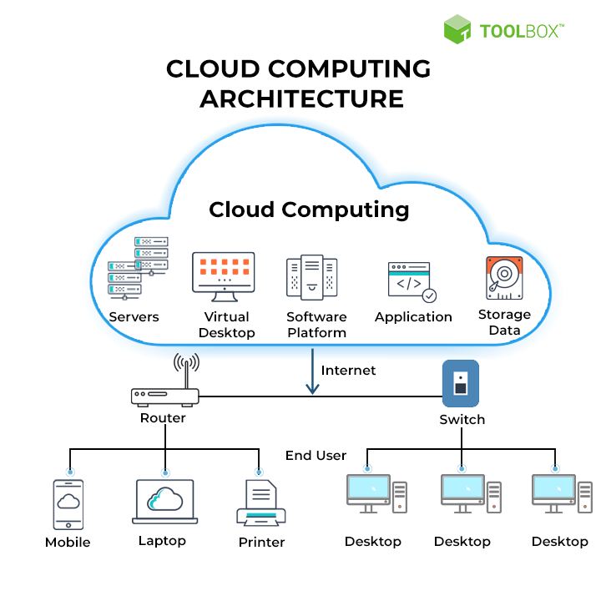

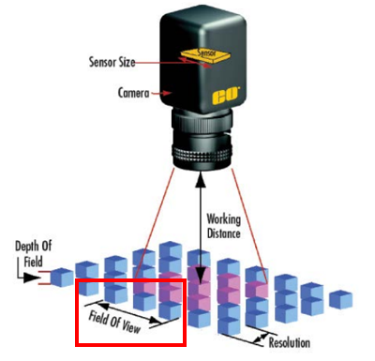
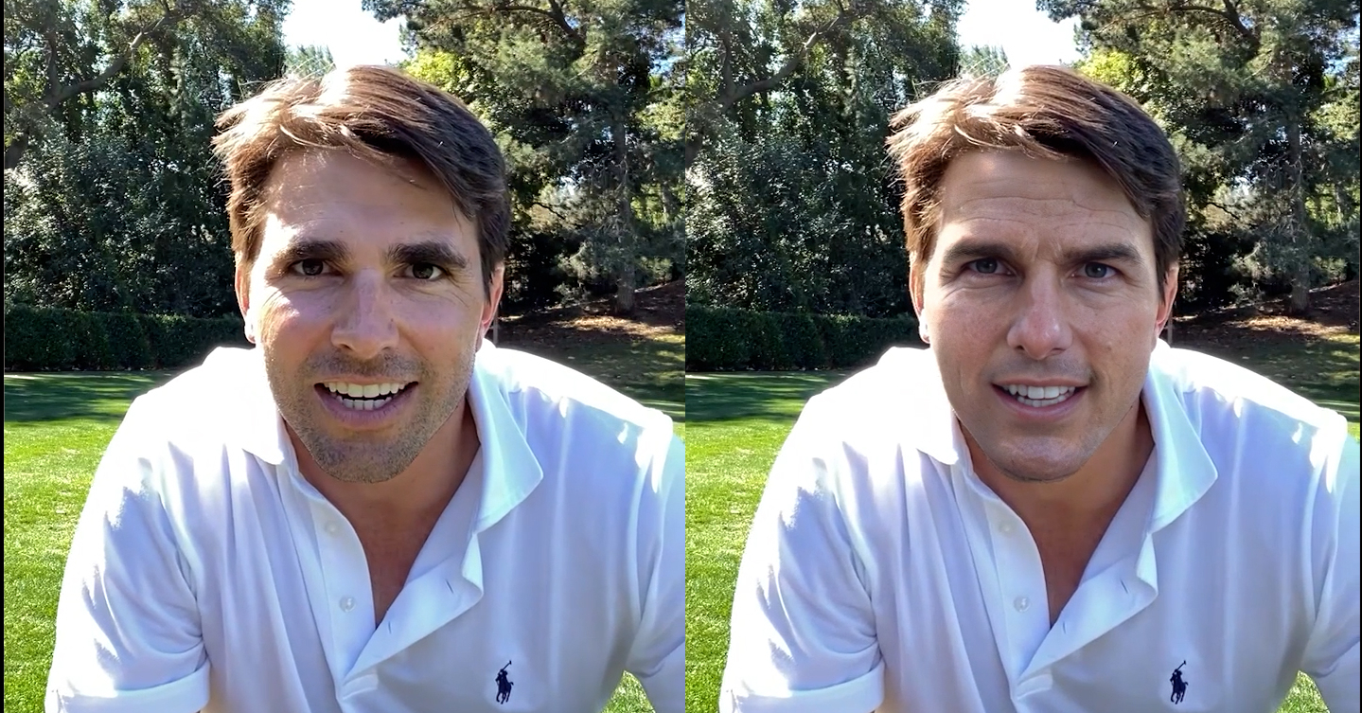
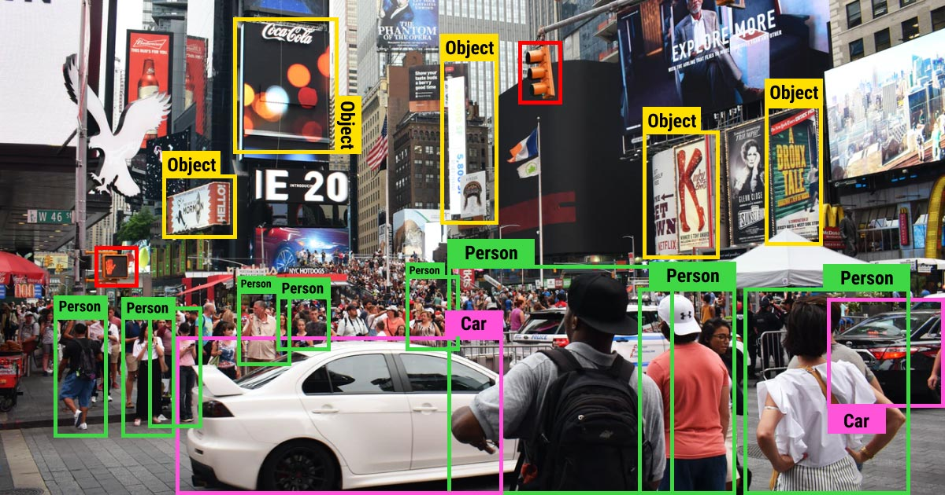
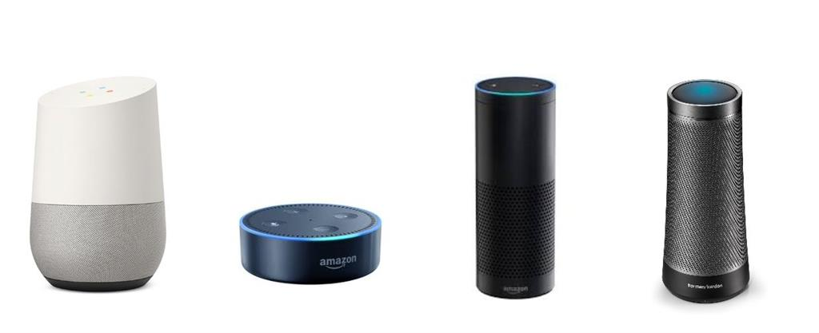
oneAPI Applications
Generative AI
Machine Learning
Cloud computing
Machine Vision
Deepfake
Image recognition
Image processing
AI Assistants

Slide 6
oneAPI Levels

Slide 7
oneAPI Toolkits
Intel oneAPI Base Toolkit
Used for data-centric application development
Intel oneAPI HPC Toolkit
Used to create and optimize applications in computing systems
Intel AI Analytics Toolkit
Used to accelerate ML pipelines using Python tools
Intel oneAPI IoT Toolkit
Used to help in IoT system design and development
Intel oneAPI Rendering Toolkit
Used to accelerate digital content and media
Intel System Bring-Up Toolkit
Used on Industrial debugging and analysis

Slide 8
Intel oneAPI Base Toolkit
A new programming language = Data Parallel C++ or DPC++
Intel oneAPI DPC++/C++ Compiler
A list of libraries that are used as bridge between different hardware accelerators and popular frameworks
Intel Distribution for Python
Intel DPC++ Compatibility Tool
Intel VTune Profiler
Intel Advisor

Slide 9
Data Parallel C++
oneAPI’s programming language = DPC++
A combination of parallel algorithms extensions and SYCL Kernel coding style
SYCL = A standard that allows host and device code to be in the same source file
It also contains useful parallel classes and functions not include in ISO C++ or SYCL
The oneAPI Base Toolkit includes the compiler for this language. This means that:
Compiles DPC++
Compiles ISO C++
Compiles SYCL

Slide 10
Included Libraries
oneDPL
oneDNN
oneCCL
oneDAL
oneTBB
oneVPL
oneMKL
Provides the DPC++ language
Provides DL building blocks
Provides DL communication patterns
Provides data analytics building blocks
Provides parallelism usage and mapping
Provides portable media pipelines creation
Provides mathematical routines for HPC

Slide 11
Intel DPC++ Compatibility Tool
The most famous API for direct programming on specific Parallel Architectures (mostly GPUs) is CUDA (Compute Unified Device Architecture)
CUDA, however, is only supported for NVIDIA devices
Thus, Intel developed the Compatibility tool that converts CUDA code into DPC++ code
The tool outputs up to a 90 to 95% accuracy translated code
After some formatting alterations to the outputted code, the new code will run as the original CUDA code
The new code should have little to none loss in performance

Slide 12

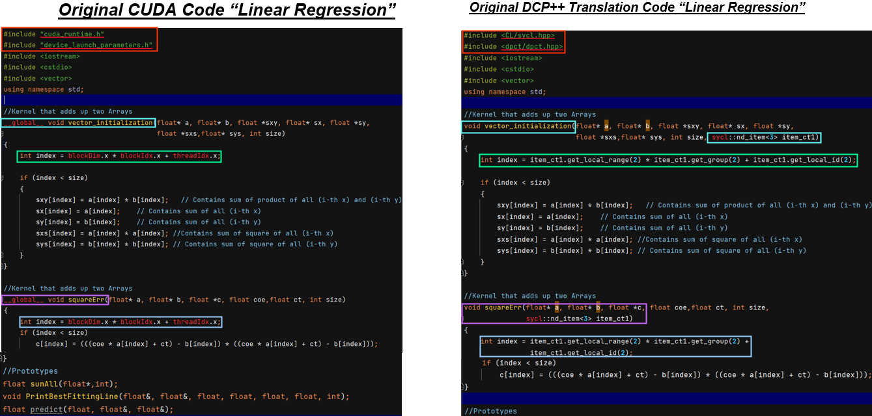

Slide 13
What if I want to focus on AI development?

Slide 14
Intel AI Analytics Toolkit
The Toolkit specifically oriented towards ML Model creation and ML implementation
Meant to be used inside the environment a regular Data Scientist work on
Provides optimization in Machine Learning phases:
Data acquisition and preprocessing → Intel Accelerated Pandas
Computing, processing an ML implementation → Intel Accelerated NumPy and SciPy
Offers support for popular frameworks like:
TensorFlow
Pytorch

Slide 15
What’s included?
Intel Optimization for TensorFlow
Intel Optimization for PyTorch
Model Zoo for Intel Architecture
Intel Neural Compressor
Intel Extension for Scikit-learn
Intel Optimization for XGBoost
Intel Distribution of Modin

Slide 16
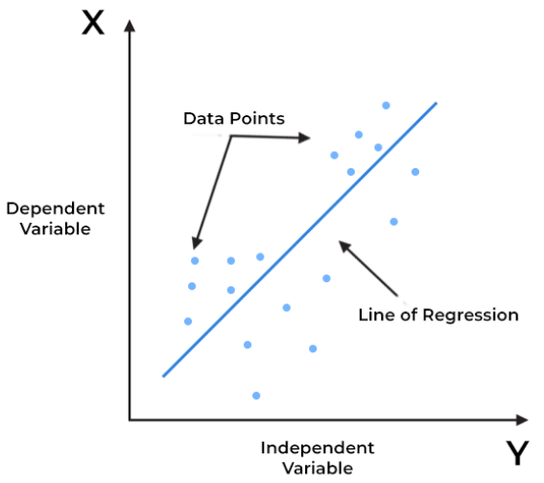
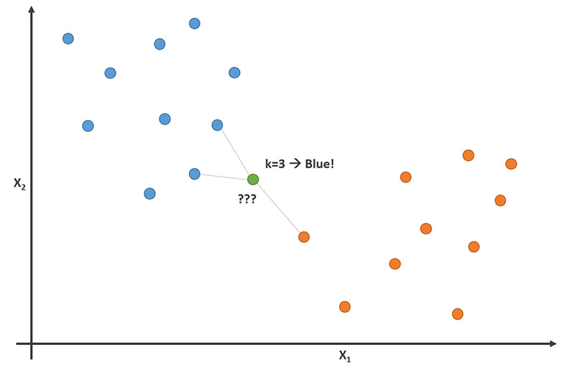
General ML

Slide 17
oneMKL & oneDAL
oneMKL = The fundamental math library that provides classes and functions used in general ML
oneDAL = The library use to accelerate all stages of data analysis
Some of the popular libraries both MKL and DAL help improve are the following:
NumPy
SciPy
Scikit learn
daal4py

Slide 18
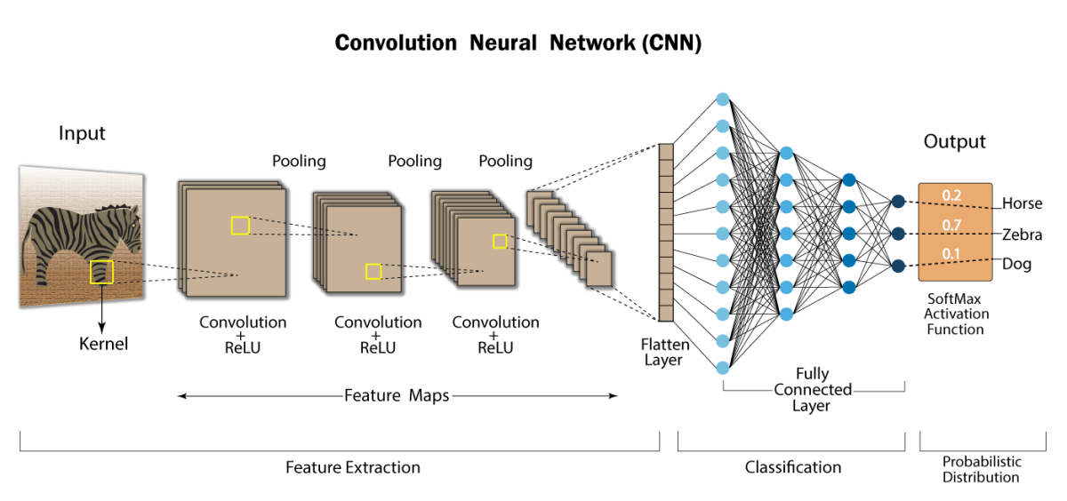
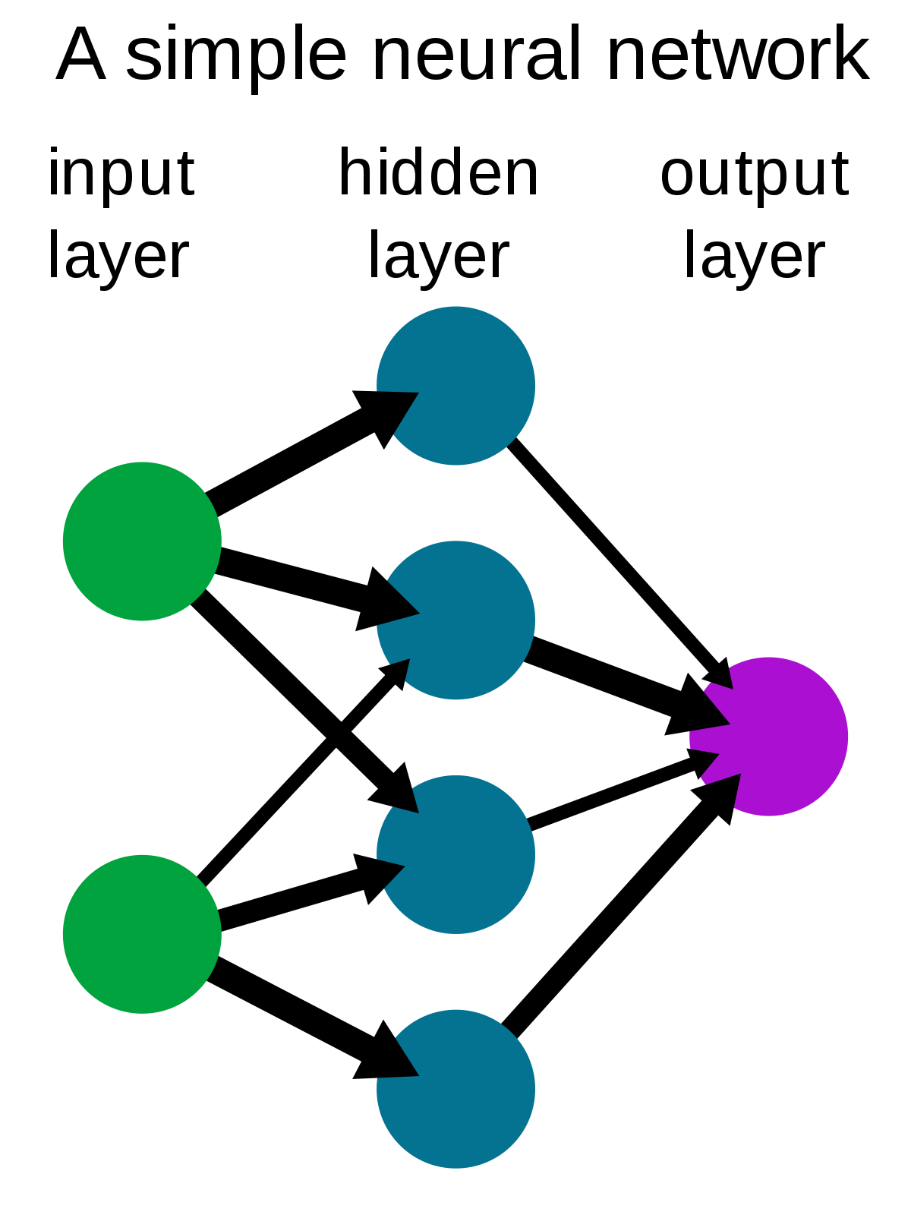
Deep Learning

Slide 19
oneDNN
The Deep Neural Network library or oneDNN offers a wide range of commonly use functions in Deep Learning models and in Machine Learning frameworks.
At a base level, you can directly copy the repository for this library and start using it in low-level applications
At an intermediate level, you can directly install it in your environment, and then modify a few lines of regular functions to use the library
Some key things it support:
CNN Primitives, RNN Primitives, Normalizations, etc.

Slide 20
oneCCL
The Collective Communication Library or oneCLL provides primitives for the communication patterns that occur in deep learning applications
Supports both scale-up for platforms with multiple oneAPI devices and scale-out for clusters with multiple compute nodes
Some communications patterns it supports:
allgathervall
reduceall
toallv

Slide 21
What now?

Slide 22
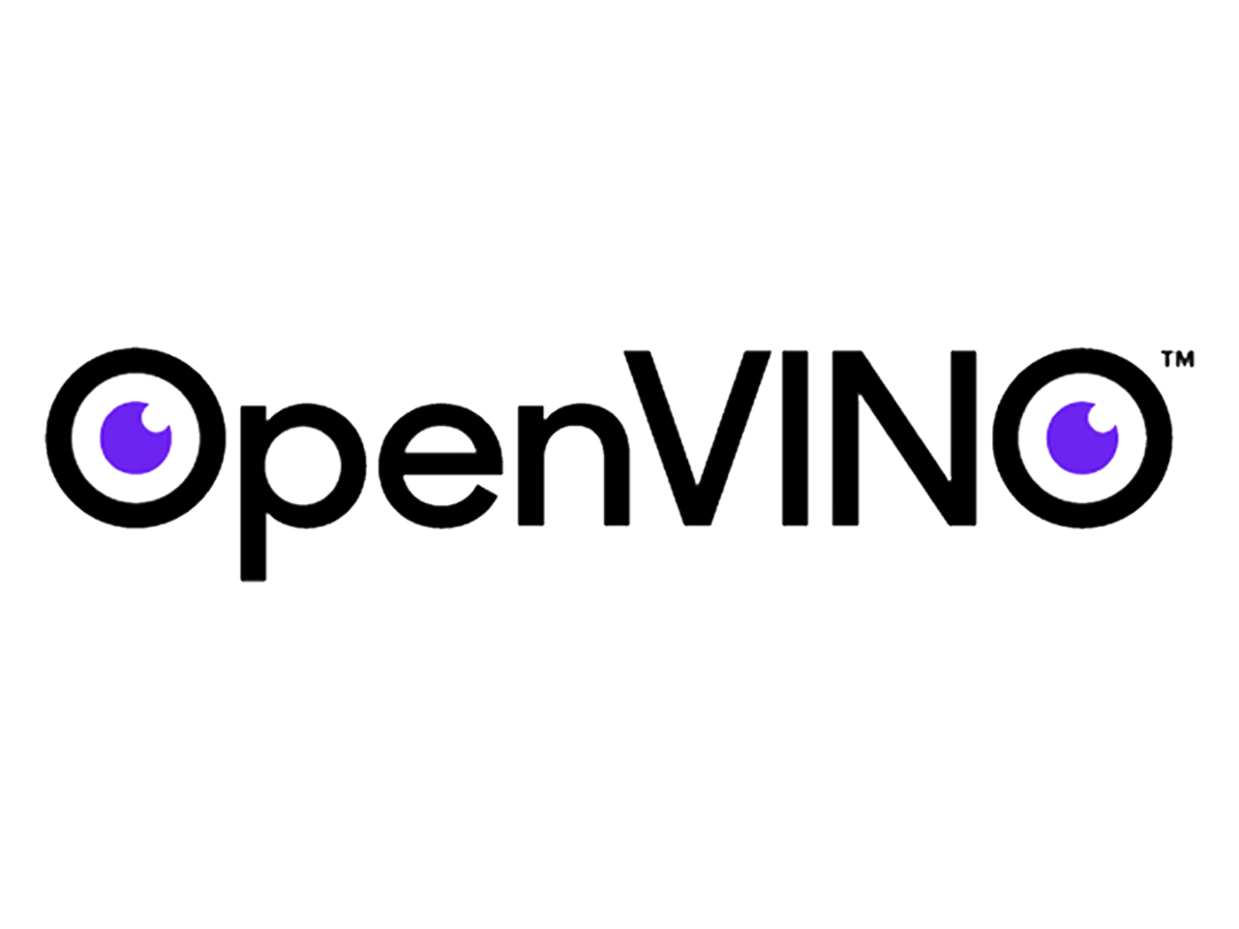
What is OpenVINO?
Open Visual Inferencing and Neural Network Optimization
A Toolkit that aims to accelerate Deep Learning Inference
It provides the following:
Develop your deep learning inference applications
Deploy them across all the supported hardware platforms
No need to rewrite your base code
It has two main parts:
The Model Optimizer
The Inference

Slide 23
OpenVINO Utilities
Deployment Manager = helps minimize the runtime package for your hardware target device
Post Training Optimization Toolkit = enables quantization from FP32 or FP16 to INT8
The Benchmark App = provides performance estimate of your model across various hardware platforms
DL Workbench = a web-based user interface extension of OpenVINO with various performance profiling utilities
DL Streamer = aimed at enabling you to create and deploy optimized streaming media analytics pipelines

Slide 24
Model Optimizer
A cross-platform command-line tool that does the following:
Facilitates the transition between training and deployment environments
Performs static model analysis
Adjusts deep learning models for optimal execution on end-point target dev
It outputs an Intermediate Representation or IR for short. This is composed of two files:
.xml → Describes the Neural Network topology
.bin → Contains the weights and biases data
The Intermediate File is the input of the Inference Engine

Slide 25
Inference Engine
A set of C++ libraries providing a common API to deliver inference solutions on different hardware.
The Inference Engine deploys the Intermediate Representation into the device you want to use it
Each hardware has a specific plugin that the inference engine includes:
CPU = DNNL plugins
GPU = clDNN plugins
VPU = HDDL plugins
FPGA = FPGA plugins

Slide 26
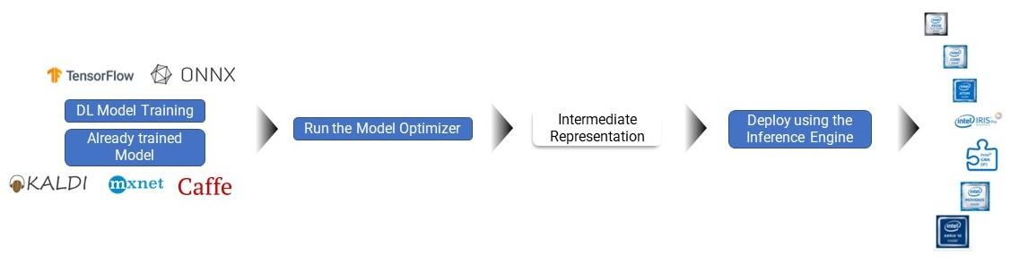
OpenVINO Workflow

Slide 27
Open Model Zoo
A cluster of wide variety of free, pre-trained deep learning models and demo applications
It provides full application templates to help you implement deep learning in:
Python
C++
OpenCV Graph API (G-API).
It consist of over 200 Neural Network models from public coders and Intel
Some application vary from:
object detection, classification, image segmentation, and others

Slide 28
Kahoot Quiz

Slide 29
Let’s gets started!

